Slide 1
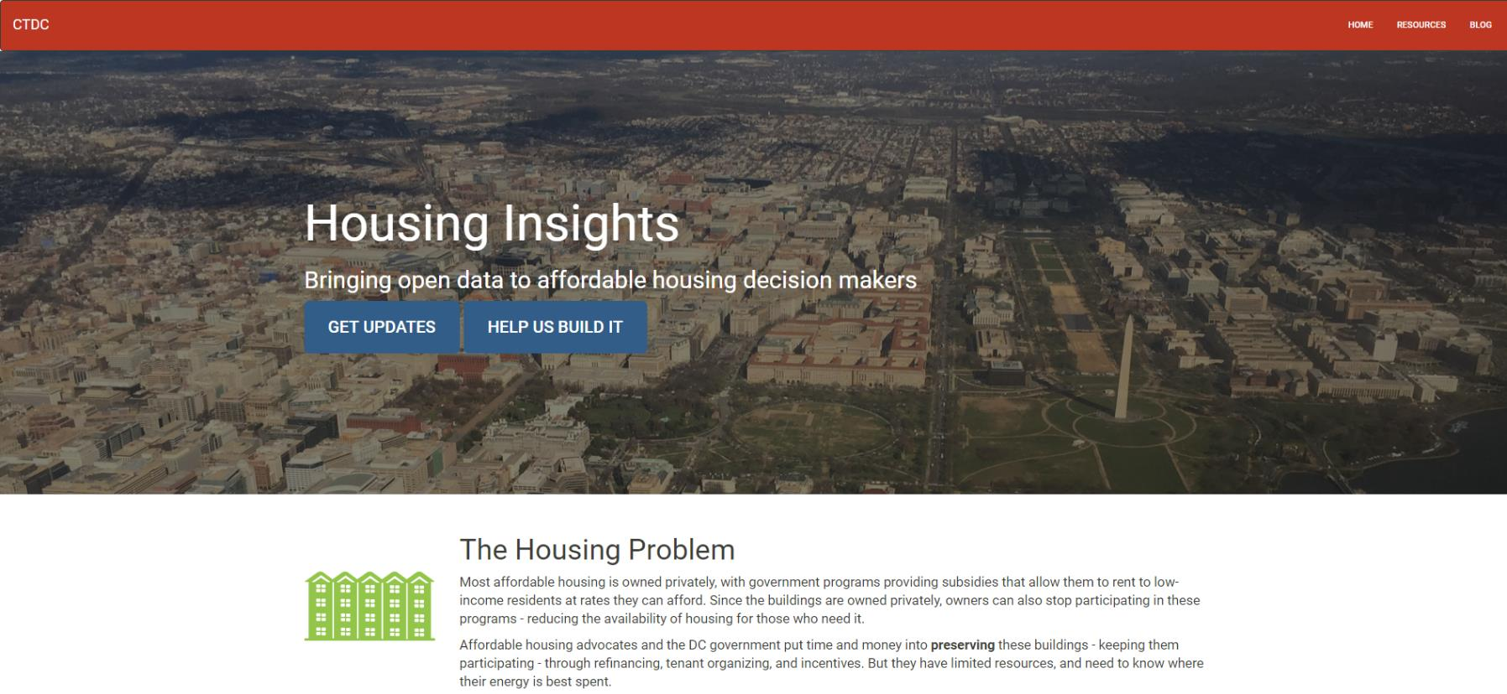
Open Data for Affordable Housing Policy
Notes:
PETER: Focus is on affordable housing preservation in Washington, DC.
Had previously decided to do something on affordable housing: priority issue for city as well as CTDC partners.
During planning process, we spoke with key stakeholders, including housing agency heads, Mayor’s office, nonprofit developers and affordable housing advocates.
Consensus emerged that a tool to apply data to support decision making around affordable housing preservation would be most useful course to pursue.
Builds on work that the DC Preservation Network (preservation strategy) and city (Strike Force) have been doing.

Slide 2


The Problem
Affordable Housing
Data
DC spends $200M+ on affordable housing per year
Application-based process is reactionary (not proactive)
Data isn’t centralized
Neighborhood info is relevant
Comparing buildings or neighborhoods improves understanding

Slide 3
Alpha Website:
http://housinginsights.org/tool/map-view.html

Slide 4
What’s next
Lots more data
Analysis and custom visualizations to add value
Testing with users
Rinse and repeat

Slide 5

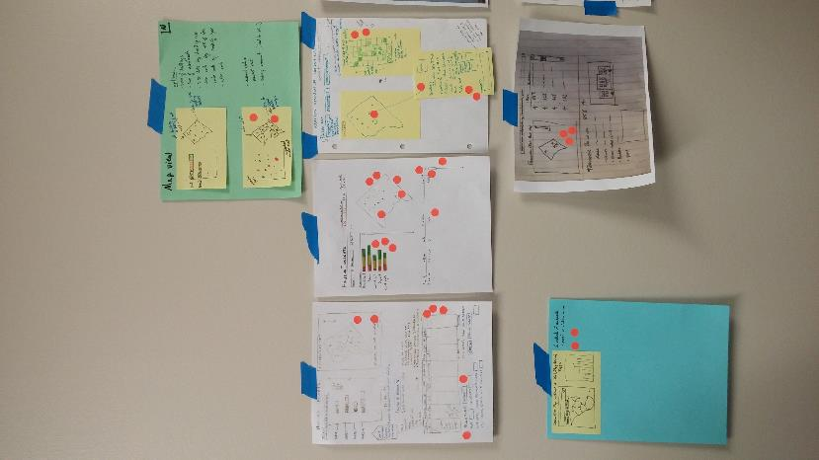
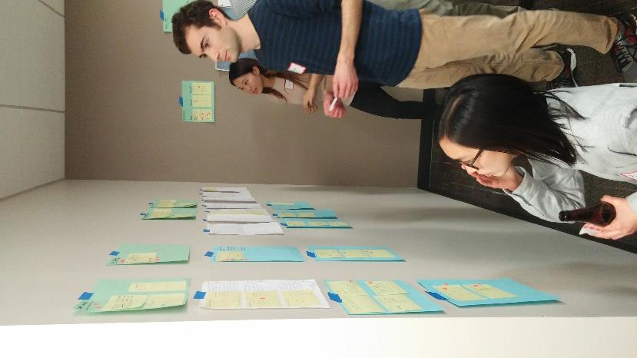
Civic Tech in Action

Slide 6

Civic Tech in Action

Slide 7
Join us!
housinginsights.org
codefordc.org
Javascript / D3
Python
Data analysis
CSS / Designers
User tester

Slide 8
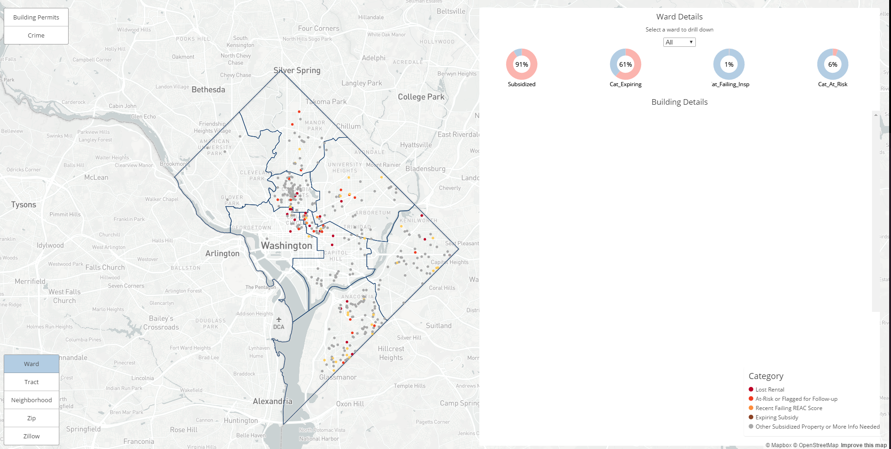

Slide 9
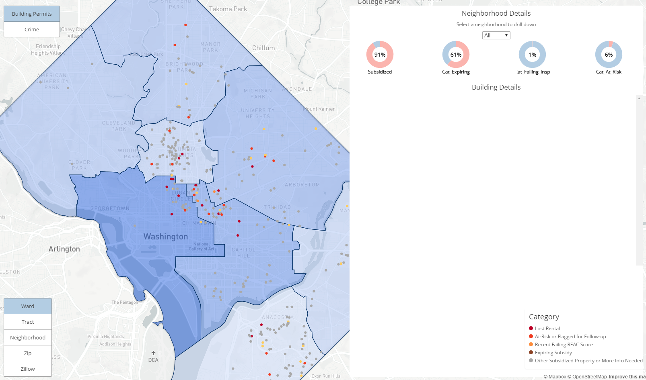

Slide 10
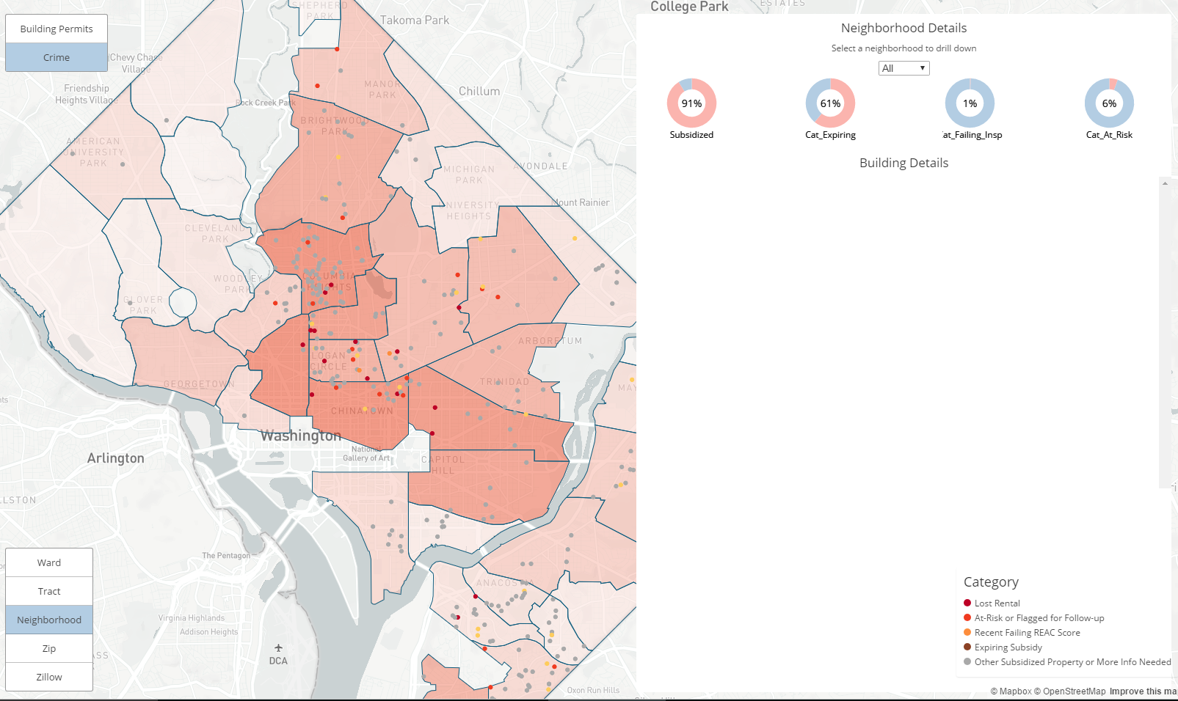

Slide 11
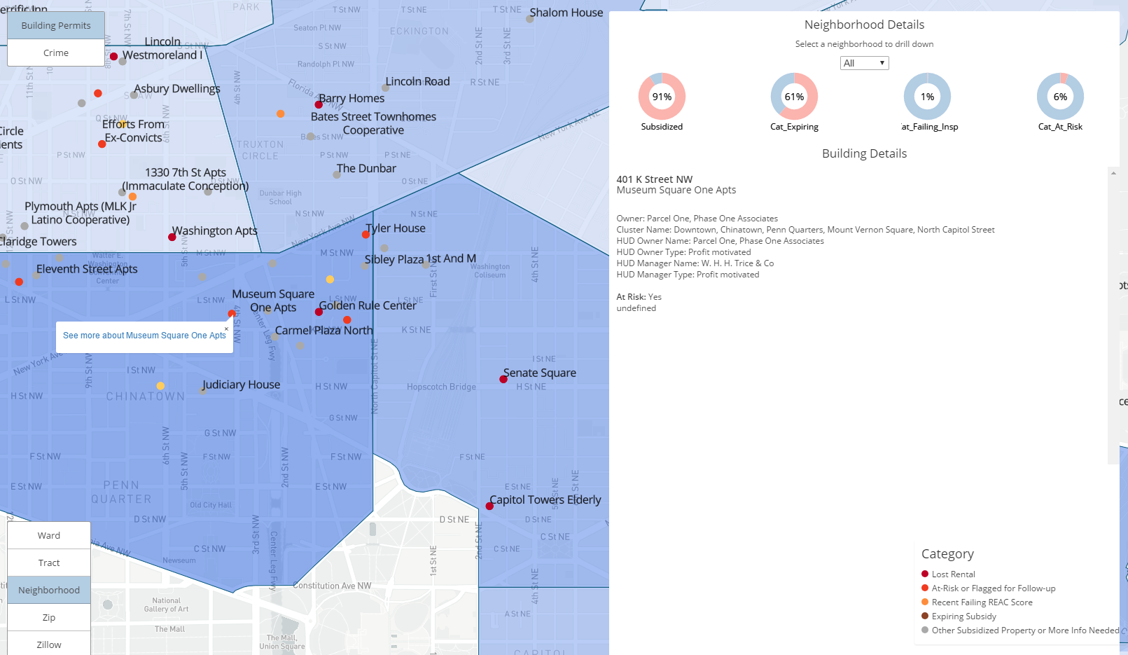

Slide 12
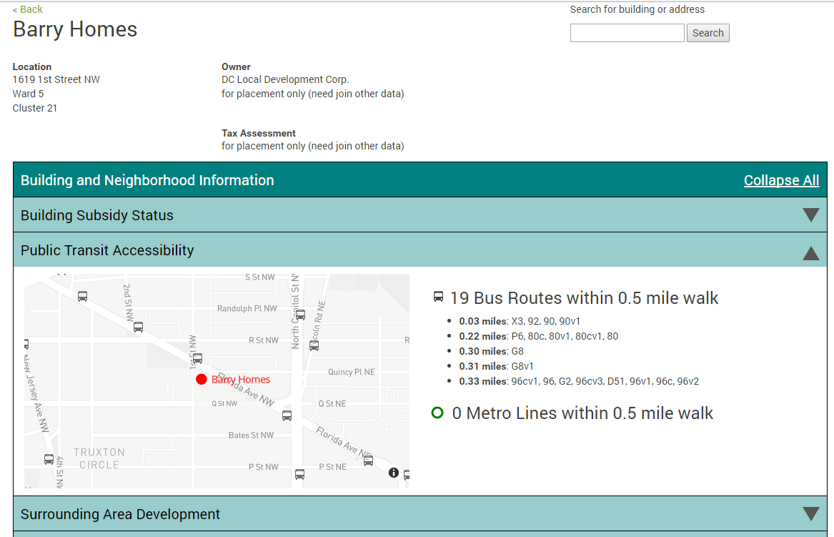

Slide 13
